Slide 1
WASC Town Hall
Steering & Self-Study Committee

Slide 2
Agenda for Town Hall
Overview of WASC and Timeline
Quick summary of each Chapter
Breakout discussion for each Chapter

Slide 3
Town Hall Format
Select a topic / Chapter (topics will be up on screen)
Facilitator will give a brief overview of the chapter and major themes/questions and moderate
Note taker at each area
12 Minutes at each topic area then you may switch (you may also stay at the table if you wish)
Each area also has index cards and pens in case you would like write your thoughts / questions down

Slide 4
Western Association for Schools and Colleges (WASC)
WASC Overview
Accredits K-12 schools and postsecondary institutions.
Peer-review process to improve student success
Provide evidence supporting student success.
Reaccreditation process every 8-10 years.
HSU Reaccreditation
Timeline
July 25th, 2017 = Self-Study Report Due
October 10th, 2017 = Offsite Review
March 21st to 23rd, 2018 = Evaluation Team Visit
Self-Study Report
Telling “our story” = Implementation of the Strategic Plan
Report has to address previous WASC recommendations

Slide 5
WASC: Chapter Contents & Committee Members
Chapter 1: Institutional Context
Cyril Oberlander, Alicia Perrson
Chapter 2: Compliance with Standards
Mary Glenn, Cyril Oberlander, Alicia Perrson
Chapter 3: Degree Programs (Meaning, Quality, Integrity)
Joseph Dieme, Monty Mola, David Sleeth-Keppler
Chapter 4: Educational Quality (Student Learning, Core Competencies)
Dale Oliver, Sarah Fay Philips, Andrew Stubblefield
Chapter 5: Student Success (Learning, Retention, Graduation)
Glo Brown, Lisa Castellino, Adrienne Colgrove-Raymond, Candace Young
Chapter 6: Quality Assurance and Improvement (Program Review, Assessment)
Bella Gray, Julie Koeppel, Rick Zechman, Noah Zerbe
Chapter 7: Sustainability (Financial Viability)
Rock Braithwaite, Traci Ferdolage, Joshua Frye, Denice Helwig

Slide 6
Chapter 1: HSU & You: Who are we?
GOAL: History, Mission, Core Constituencies, Recent Changes… a picture of the institution’s distinctive character.
WASC Standard 1:
Defining Institutional Purposes and Ensuring Educational Objectives
Institutional Purposes
1.1 Formally approved, appropriate statements of purpose that define values and character
1.2 Clear educational objectives; indicators of student achievement at institution, program and course levels; retention/graduation data and evidence of student learning made public
Integrity and Transparency
1.3 Academic freedom: policies and practices
1.4 Diversity: policies, programs, and practices
1.5 Education as primary purpose; autonomy from external entities
1.6 Truthful representation to students/public; fair and equitable policies; timely completion
1.7 Operational integrity; sound business practices; timely and fair responses to complaints; evaluation of institutional performance
1.8 Honest, open communication with WSCUC including notification of material matters; implementation of WSCUC policies
Student Demographic Changes
Building the Capacity for Change 2010
Cabinet for Institutional Change
Program Review Process (PREP) 2012
Launched new program review
Residential Academic Mentoring Program 2012
RAMP formed
Retention & Inclusive Student Success 2014
Cabinet for Institutional Change
Strategic Plan 2015
Reaffirmation of Mission
Innovations
Klamath Connection, RFY, CSU Grad Initiative 2025
Add your voice & understanding

Slide 7
Chapter 3: Meaning, Quality, Integrity of Degree (Institutional View)
1.1 Mission, Vision, Values, University SLOs for baccalaureate and master's degrees; Informal definitions of meaning of HSU degree
1.2 Some programs have evidence of goal attainment for courses and programs; OIR has data on retention/achievement
2.1 Program review and assessment; Generally, programs are appropriate in content as evidenced by program review and department faculty
2.2 Admissions requirements; levels of achievement for graduation; have program review, 5-year assessment reports, diversity reports, undergraduate and graduate degree requirements;
4.3 Commitment to improvement as evidenced in program reviews, annual department reports
4.6 Strategic plan that connects with WASC
Needs/gaps: Assessment of university-level meaning, quality, integrity; external norms of comparison of learning; consistent participation in program review; conversations around assessment and pedagogy among faculty; institutional assessment/effectiveness structures
QUESTION:
How would you define and measure Meaning, Quality, Integrity of HSU degree for everyone?
Which structures should be in place?

Slide 8
Chapter 4: Educational Quality Student Learning, Core Competencies, & Standards of Performance at Graduation
Student Learning:
What do students learn?
How well do students learn?
Core Competencies:
How well do students perform at or near graduation?
Written Communication, Oral Communication, Information Literacy, Quantitative Reasoning and Critical Thinking
Additional Questions:
How does the institution know?
What’s “good enough”?

Slide 9
Chapter 5: Student Success
Student Learning, Retention, and Graduation
ACCESS: Recruitment, Orientation, Enrolling Incoming Students
ACADEMIC SUPPORT: Inclusive Environment, Campus Engagement, High Impact Practices
RETENTION: Health & Wellness, Cultural Identity Development, Career Planning
GRADUATION: Academic Advising, Internships, Cultural Relevancy,
QUESTIONS:
How are we doing “closing the gap” in achievement?
What assessments are driving our programming and priorities?

Slide 10
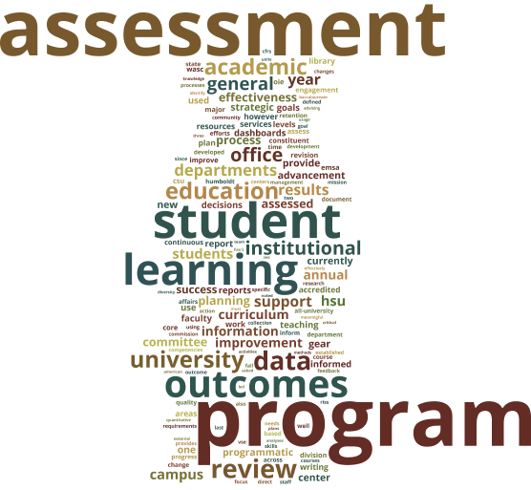
Chapter 6: Quality Assurance and Improvement
Historical Overview: Uneven progress on assessment
Non-Academic Program Review
Next Steps: Office of Educational Effectiveness

Slide 11
Chapter 7: Sustainability (Financial Viability); Preparing for the Changing Higher Education Environment
“Bring prioritization process to logical conclusions in decisions about resource allocations” (WASC EER Report, 2010)
2009 Cabinet for Institutional Change developed
Connection between Strategic Plan and WASC Recommendations
Financial Strategic Plan = Strategic Budgeting
Academic Tactical Plan = Prioritization
Enrollment Management
Maintaining Focus on Institutional Effectiveness
Questions
What developments are occurring in California, the US, and globally that pose threats and opportunities for HSU to remain viable as an institution, continue to improve, and achieve its mission?
What specific strengths and weaknesses does HSU have or need to develop in order to respond effectively to these external developments?

Slide 12
Town Hall Format
Select a topic / Chapter (topics will be up on screen)
Facilitator will give a brief overview of the chapter and major themes/questions and moderate
Note-taker at each area
12 Minutes at each topic area then you may switch (you may also stay at the table if you wish)
Each area also has index cards and pens in case you would like write your thoughts / questions down

